Slide 1
Printer
Multi function Epson Colour Ink Tank Printer

Slide 2
Dell Computers
Desktop Computers With i7 processorand 16 GB RAM

Slide 3
Motherboard Trainer Kit
Trainer Board to study Mother Board

Slide 4
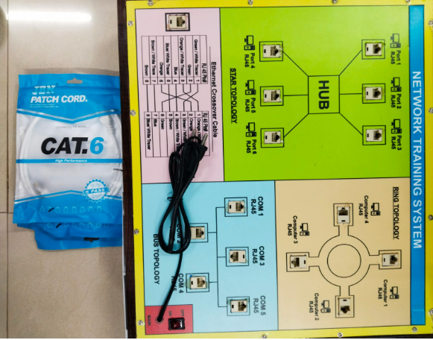
Network Training System
Sigma LAN trainer kits with simulation Software

Slide 6
Projector
Zerbronics Pixalay 21 white Projector

Slide 7
Audio IOT Project
REE552IOT kit for Audio IOT Project

Slide 8
DIY Path Tracking Robot Car Kit
amici Smart DIY Path Tracking Robot Car Kit

Slide 9
RASPERRY PIN IOT TRAINER
Singma Rasperry Pin IOT Trainer

Slide 10
External Hard Disk
Silicon Power Armour A30 External Hard Drive

Slide 11
Pi Camera

Slide 12
Raspberry Pi4 kit
Raspberry Pi4 Kit with case

Slide 13
Arduino Kit
Arduino Kit with case

Slide 14
Display Board
Display Board

Slide 15
Micro USB OTG
Micro USB OTG for Pi

